Slide 1
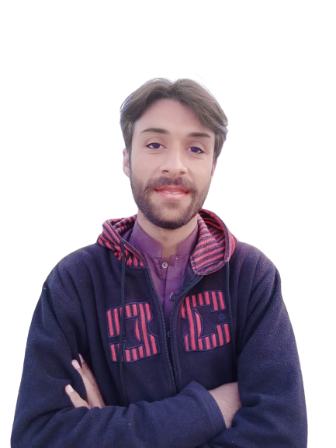
Complex Task Series
Problem Number 27

Slide 2
Problem Statement
Write a Python Program to Blur an image

Slide 3
Algorithm
Step1: Read an image
Step2: Set a Blur value to Blur image
Step3: Display Blur image to user
END

Slide 4
Assignment
Write a Python Program to blur an image on web

